Slide 1
PROJECT TITLE
CAPSTONE PROJECT
Presented By:
1. Anushka Sharma-MIT AOE Pune-Btech ENTC

Slide 2
OUTLINE
Problem Statement (Should not include solution)
Proposed System/Solution
System Development Approach (Technology Used)
Algorithm & Deployment
Result (Output Image)
Conclusion
Future Scope
References

Slide 3
Problem Statement
A College Admission Agent, powered by RAG (Retrieval-Augmented Generation), streamlines the student admission process. It retrieves and summarizes admission policies, eligibility criteria, and FAQs from institutional databases and official sources. Prospective students can ask natural language questions and receive accurate, up-to-date responses instantly. The agent helps with course selection, application guidance, fee structure, and important deadlines. Using trusted, real-time data, it reduces manual inquiries and enhances applicant experience. This AI-driven assistant boosts transparency, accessibility, and efficiency in college admissions

Slide 4
Proposed Solution 1. Data Collection: Aggregate admission-related documents such as policies, eligibility criteria, course catalogs, FAQs, and fee structures from institutional databases, official college websites, and government education portals. Integrate with APIs or authorized data repositories for real-time access to updates on admission dates, application processes, and seat availability.
1. Data Collection:
Aggregate admission-related documents such as policies, eligibility criteria, course catalogs, FAQs, and fee structures from institutional databases, official college websites, and government education portals.
Integrate with APIs or authorized data repositories for real-time access to updates on admission dates, application processes, and seat availability.
2. Data Preprocessing:
Clean and structure unorganized or semi-structured documents using NLP techniques like sentence segmentation and named entity recognition (NER).
Standardize formats across different data sources for uniform retrieval and ensure removal of outdated or duplicate content.
3. Retrieval Module:
Implement a vector-based document retrieval system (e.g., FAISS, Pinecone) to enable fast and relevant extraction of information based on user queries.
Use semantic search techniques (e.g., Dense Passage Retrieval or BM25) to improve accuracy and relevance of the retrieved documents.

Slide 5
Proposed Solution 1. Data Collection: Aggregate admission-related documents such as policies, eligibility criteria, course catalogs, FAQs, and fee structures from institutional databases, official college websites, and government education portals. Integrate with APIs or authorized data repositories for real-time access to updates on admission dates, application processes, and seat availability.
4. Generation Module (RAG):
Use a pre-trained transformer model (e.g., BERT or GPT) integrated with the retriever to generate coherent, context-aware answers.
Ensure responses are grounded in retrieved documents to maintain factual accuracy and avoid hallucinations.
5. Natural Language Interface:
Design a chatbot/web interface that allows students to interact in natural language.
Include multilingual support and user personalization features (e.g., saving previous queries, suggesting relevant information).
6. Deployment:
Host the solution on a scalable cloud platform (e.g., IBM Cloud, AWS, or Azure) with proper data privacy and security compliance.
Ensure high availability and low latency response time for seamless user interaction.

Slide 6
Proposed Solution 1. Data Collection: Aggregate admission-related documents such as policies, eligibility criteria, course catalogs, FAQs, and fee structures from institutional databases, official college websites, and government education portals. Integrate with APIs or authorized data repositories for real-time access to updates on admission dates, application processes, and seat availability.
7. Evaluation:
Measure the system’s performance using metrics such as F1-score for retrieval accuracy, BLEU or ROUGE for generation quality, and user satisfaction surveys.
Continuously refine based on feedback, usage logs, and changing institutional guidelines.
Result: The AI-powered admission assistant will significantly reduce manual workload on administrative staff, provide prospective students with instant and reliable information, and increase overall satisfaction with the admission process. By leveraging real-time data and advanced NLP, it builds a smarter, faster, and more transparent college admission system.

Slide 7
System Approach
The "System Approach" section outlines the strategy and methodology for building and deploying the AI-powered college admission assistant. This system leverages NLP, retrieval mechanisms, and transformer-based language models to provide real-time, factual responses to student queries. The approach consists of the following elements:
1. System Requirements
Hardware Requirements:
Minimum 8 GB RAM (16 GB recommended for training)
4-core CPU (or GPU-enabled system for faster inference)
100 GB storage (for institutional documents and vector databases)
Software Requirements:
Operating System: Windows/Linux/MacOS
Python 3.8 or later
Git (for version control)
Web browser (for chatbot interface testing)

Slide 8
System Approach
1.Cloud Infrastructure (optional but recommended):
IBM Cloud / AWS / Azure for scalable deployment
Docker (for containerization)
MongoDB or Firebase (for user data storage) 2. Libraries Required to Build the Model
A. Data Handling and Search
pandas – Used to work with and clean data.
numpy – Helps with mathematical operations and numbers.
beautifulsoup4 or requests – Used to collect data from websites (if allowed).
langchain – Connects the chatbot with AI models using the RAG method.
faiss or pinecone-client – Helps the system search answers based on meaning, not just keywords.
sentence-transformers – Turns text into numbers (embeddings) so it can be searched easily.

Slide 9
System Approach
3. Natural Language Understanding
transformers – Gives access to powerful AI models like GPT and BERT.
nltk or spaCy – Used to break text into words, find names, and clean text.
torch or tensorflow – These are tools that run the AI models in the background.
4. User Interface (optional)
streamlit or Flask – Used to build the chatbot webpage or interface.
gradio – Makes a simple and interactive interface with very little code. 5. Deployment and Monitoring
gunicorn or uvicorn – Used to run the chatbot app on a server.
Docker – Packs the whole project so it can run easily anywhere.
Prometheus or Grafana – Optional tools to check performance and logs of the chatbot.

Slide 10
Algorithm & Deployment
Algorithm Selection:
The project employs a Retrieval-Augmented Generation (RAG) framework that combines two core components:
Retriever: A dense vector-based retriever (e.g., FAISS or Pinecone) that searches and retrieves the most relevant documents or passages based on the user’s query.
Generator: A transformer-based language model (e.g., GPT-3.5, BERT, or FLAN-T5) that uses the retrieved documents to generate accurate and context-aware responses.
Justification for RAG:
College admission queries require factually accurate and context-specific answers.
Static LLMs may hallucinate or provide outdated information.
RAG ensures grounding of generated responses in real-time, trusted institutional data, improving both accuracy and reliability.

Slide 11
Algorithm & Deployment
Data Input:
The system uses the following input features:
User Query (natural language question from the student)
Institutional Documents, including:
Admission policies
Eligibility criteria
Course details and descriptions
Fee structures
FAQs and important deadlines
Optional Enhancements:
Student's selected stream or interest area
Location/language preference for personalized results

Slide 12
Algorithm & Deployment
Training Process:
The retriever uses sentence embeddings (from models like Sentence-BERT) to map queries and documents into vector space.
A pre-trained generator model is used and optionally fine-tuned on a dataset of admission-related Q&A.
Techniques like cross-validation, human evaluation, and similarity scoring are used to improve performance.
The retriever may be improved using techniques like contrastive learning or triplet loss.
Prediction Process:
The student enters a query.
The system retrieves the most relevant documents using the retriever.
The generator model uses these documents to generate an accurate, contextual answer.
The result is shown to the user in real time, along with optional source references.
The system always works with the latest documents, so there’s no need to retrain the model each time policies are updated.
Real-Time Consideration:
Documents and policies can be updated in real time in the backend corpus, so the system always works on the latest information—without retraining the model.

Slide 13
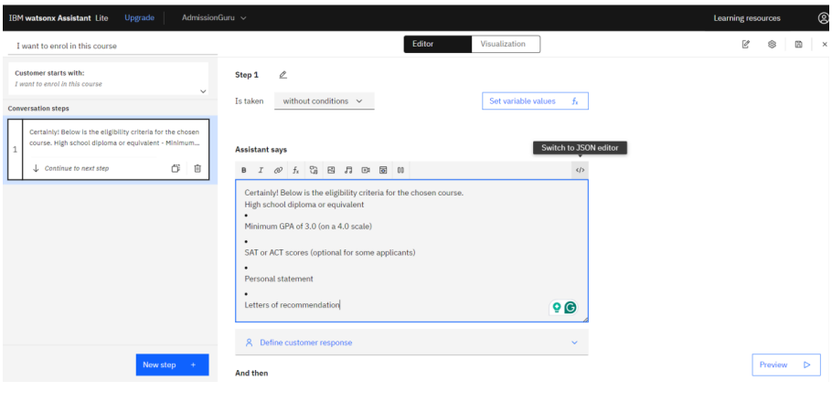
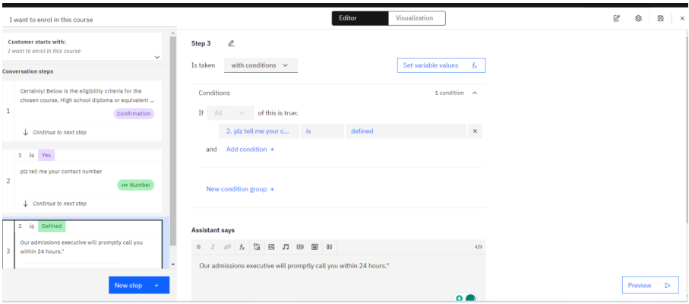
Algorithm & Deployment

Slide 14
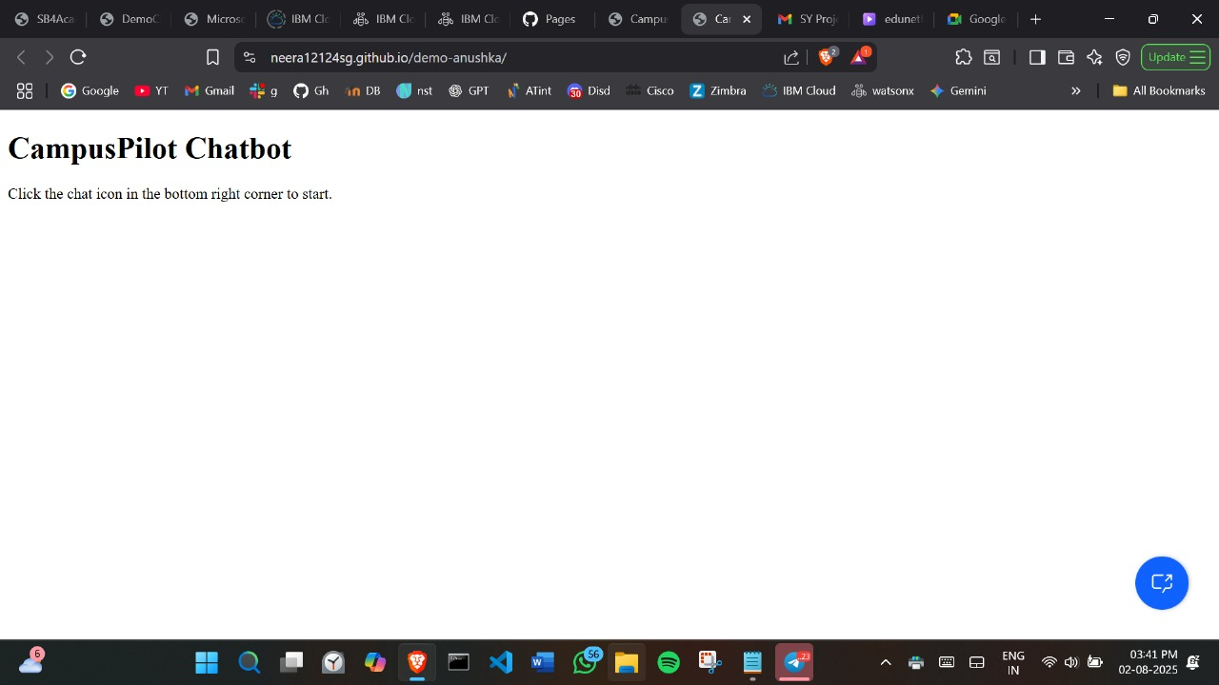
Result

Slide 15
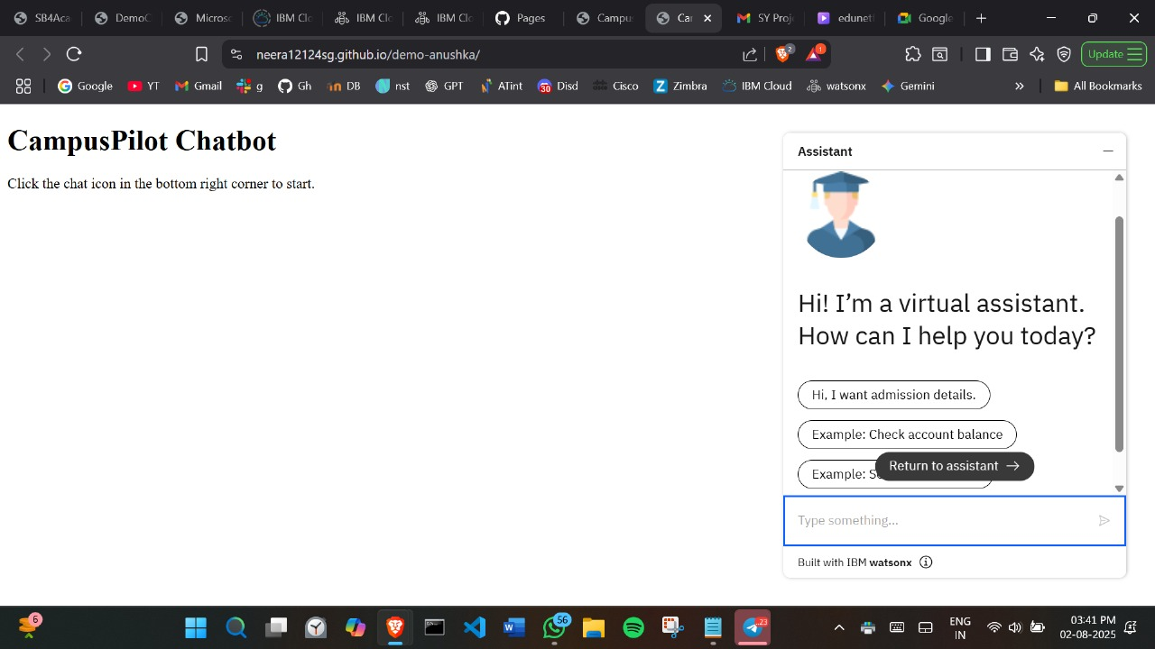
Result

Slide 16
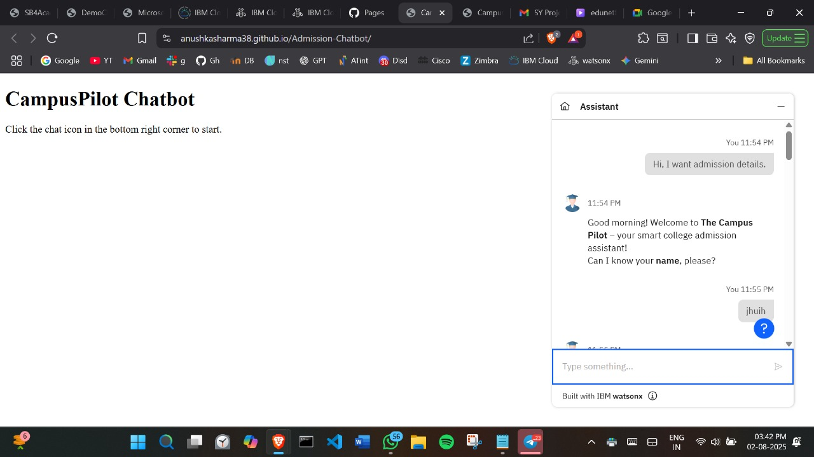
Result

Slide 17
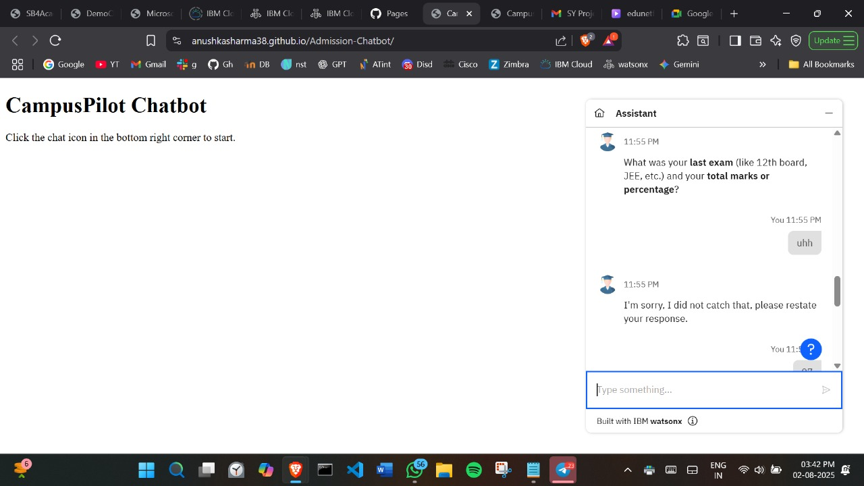
Result

Slide 18
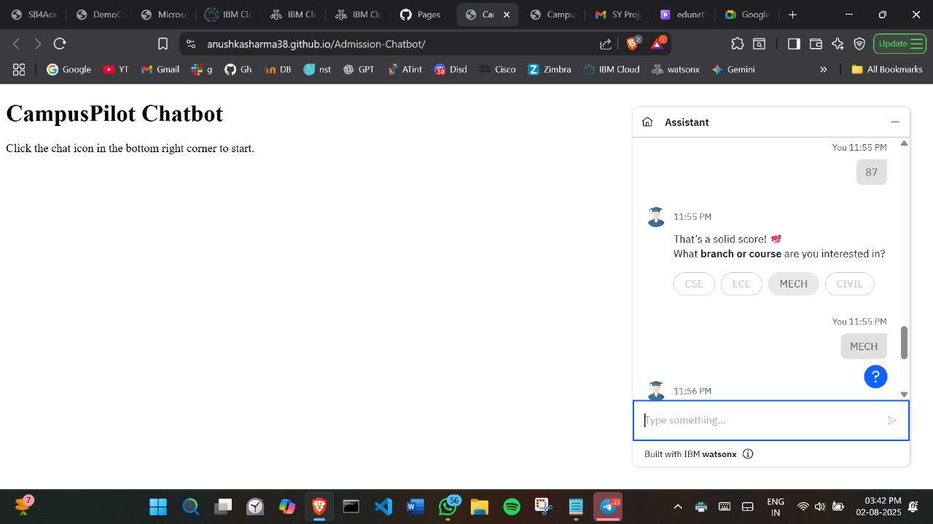
Result

Slide 19
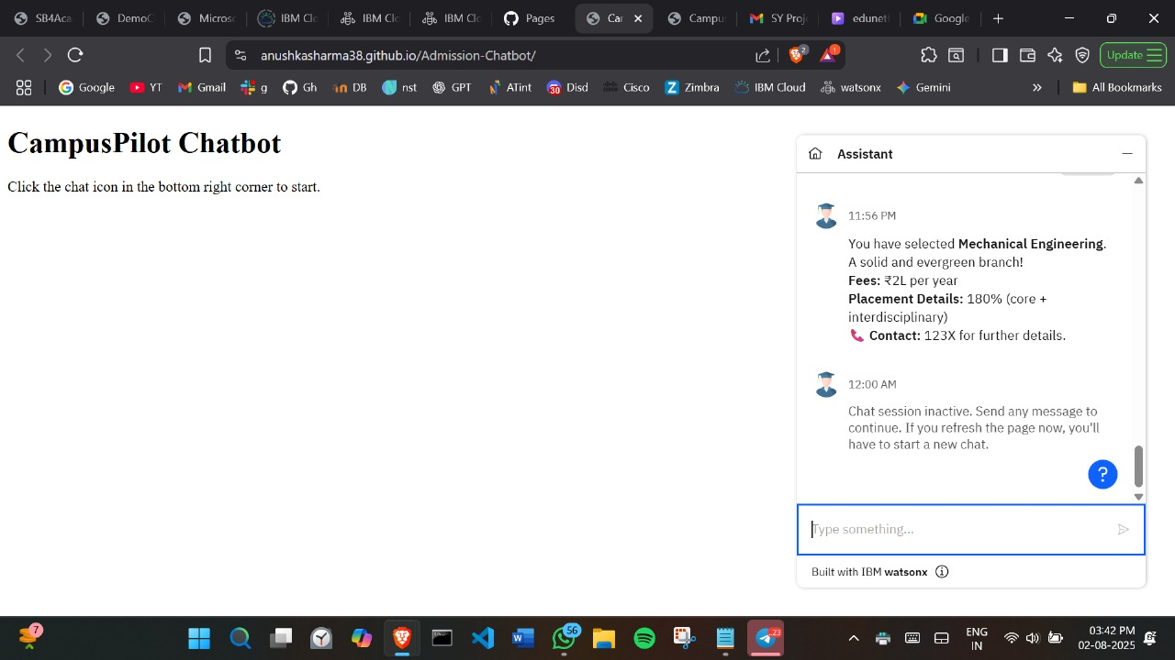
Result

Slide 20
Conclusion
The proposed College Admission Agent using RAG proved to be highly effective in delivering fast, accurate, and reliable responses to student queries. It successfully reduced manual workload and improved user experience with real-time guidance on courses, eligibility, fees, and deadlines.
Challenges Faced:
Integrating multiple data sources with different formats
Ensuring factual accuracy to prevent misinformation
Handling vague or ambiguous user queries
Potential Improvements:
Add voice input and multilingual support
Include a recommendation system for course selection
Integrate with college application portals for end-to-end assistance
Impact: This AI solution improves transparency, saves time, and ensures that students receive correct information instantly, enhancing the overall admission process.

Slide 21
Future scope
Expand Data Sources
Integrate real-time data from government portals, ranking websites, and social media to improve accuracy and relevance.
Algorithm Optimization
Fine-tune LLMs with domain-specific datasets
Use hybrid retrieval (dense + sparse) to improve response precision
Scalability Across Regions
Extend the system to support multiple colleges, cities, or states
Add language localization for regional outreach
Emerging Technology Integration
Use edge computing to reduce latency in rural or low-connectivity areas
Incorporate advanced ML models like multi-modal agents for document + voice processing
User Personalization
Recommend colleges/courses based on student interests and past queries
Store preferences for faster future responses

Slide 22
References
IBM Skills Network. Retrieval-Augmented Generation (RAG) Fundamentals. IBM Online Learning Platform. https://skills.network
IBM Cloud. AI-Powered Virtual Assistants for Business Applications. IBM Cloud Docs. https://cloud.ibm.com/docs Course PDFs, slide decks, and session notes from IBM classes attended (internal use).

Slide 23
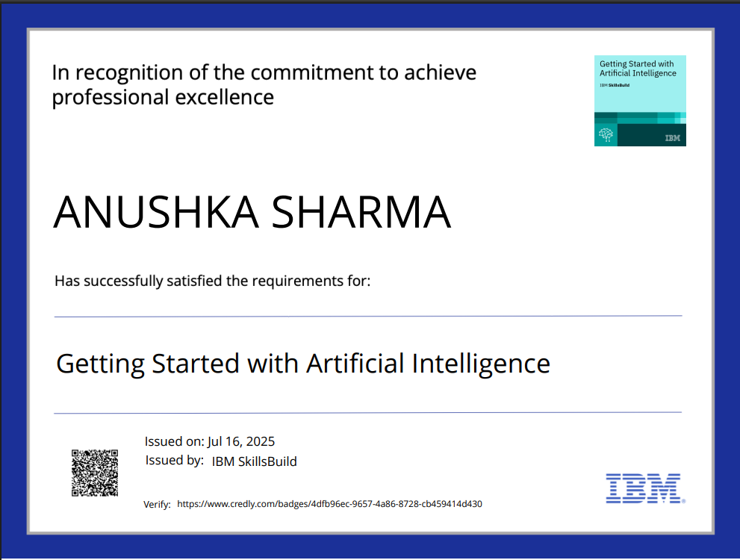
IBM Certifications

Slide 24
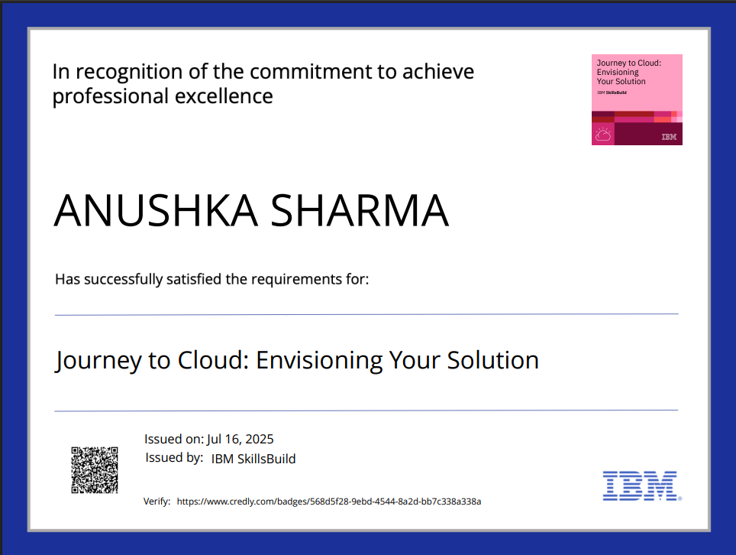
IBM Certifications

Slide 25
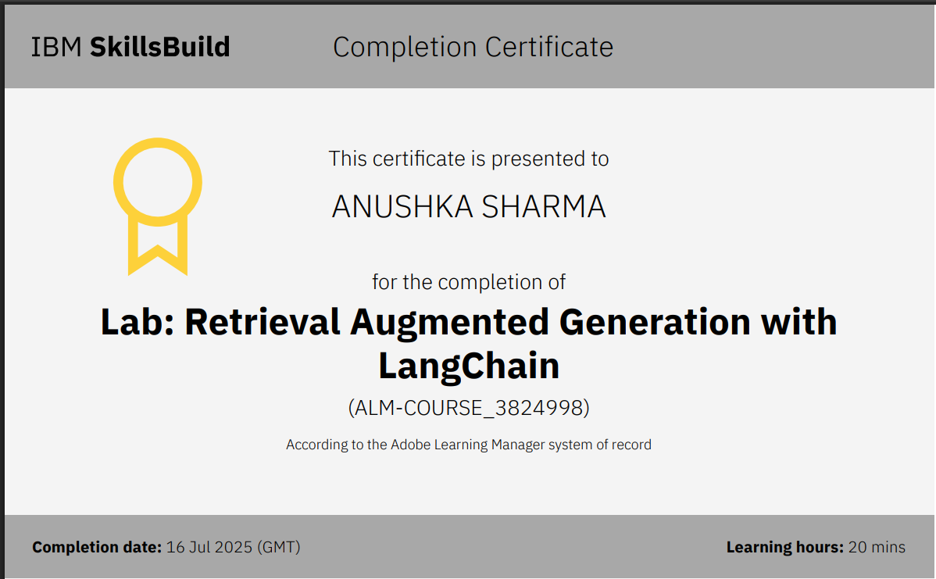
IBM Certifications

Slide 26
THANK YOU

